Slide 1
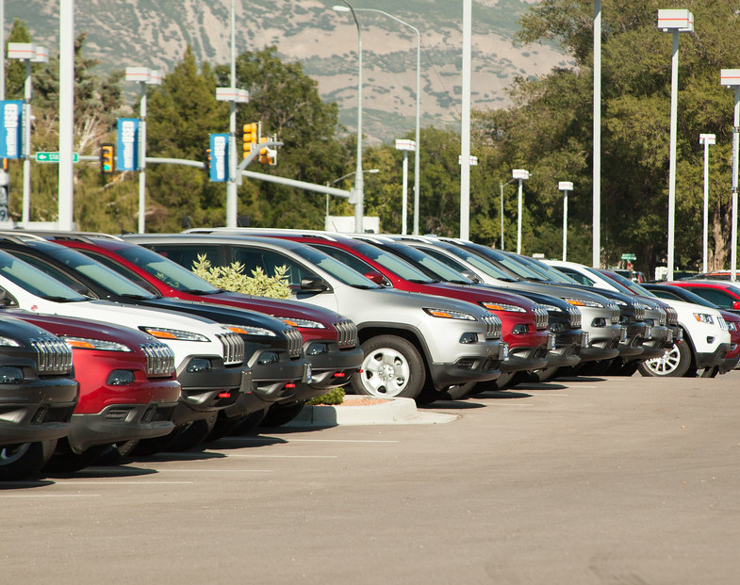
Machine Learning Predictions of Vehicle Prices
BY: Joel Miller
December 6, 2023
This Photo by Unknown Author is licensed under CC BY-SA

Slide 2
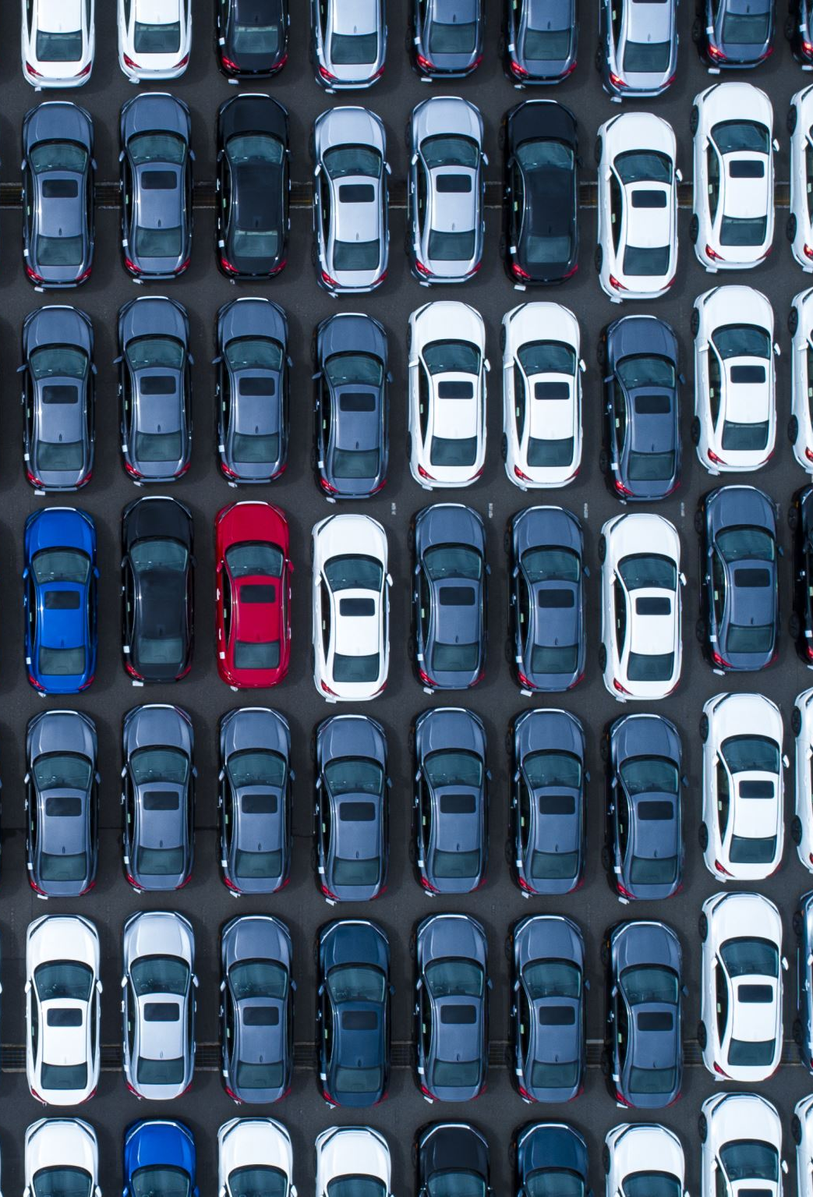
Objective
Developing a Vehicle Price Predictor:
Goal: Utilize machine learning techniques to build a robust model for predicting vehicle prices.
Benefits:
Informed Pricing Decisions: Empower dealerships and sellers with accurate price predictions.
Improved Market Competitiveness: Enhance the ability to offer competitive pricing strategies in the automotive market.

Slide 3
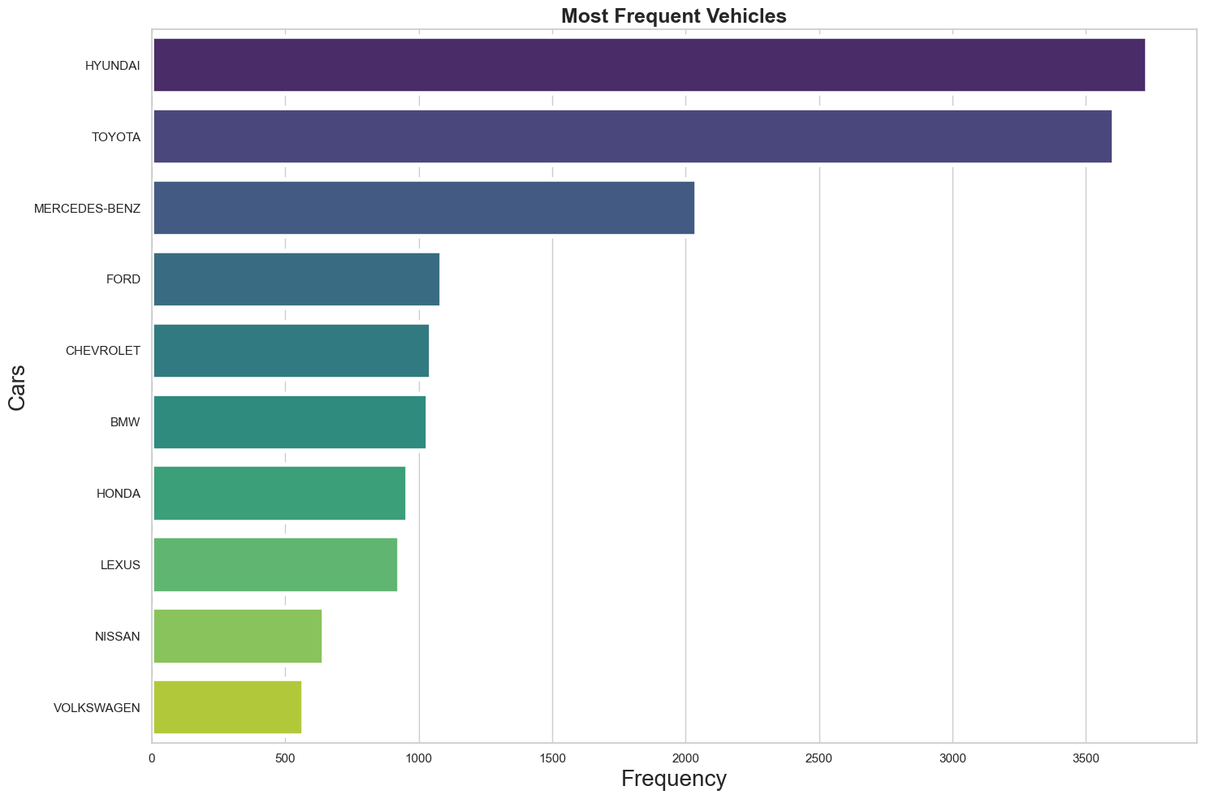
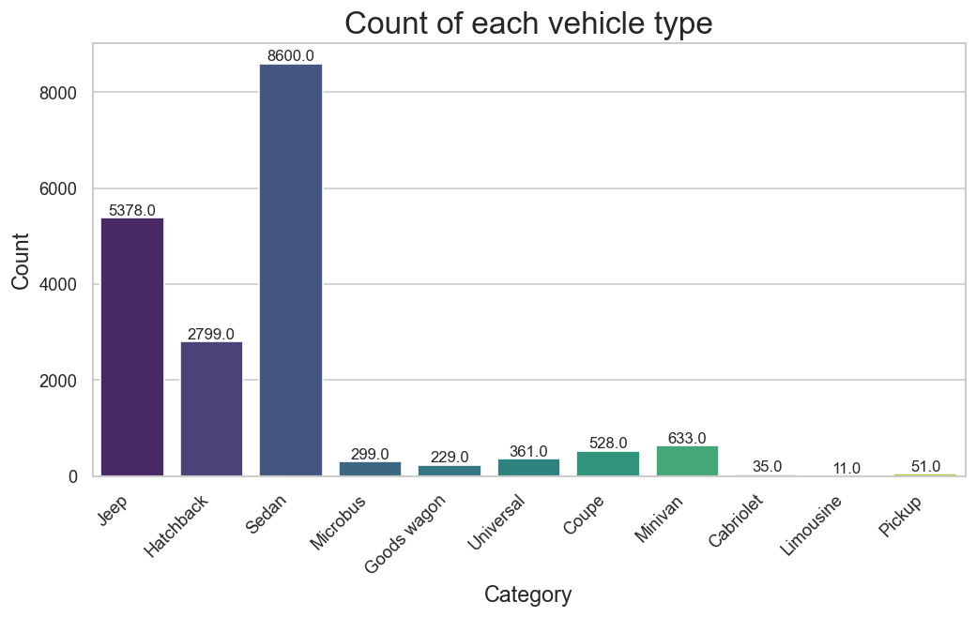
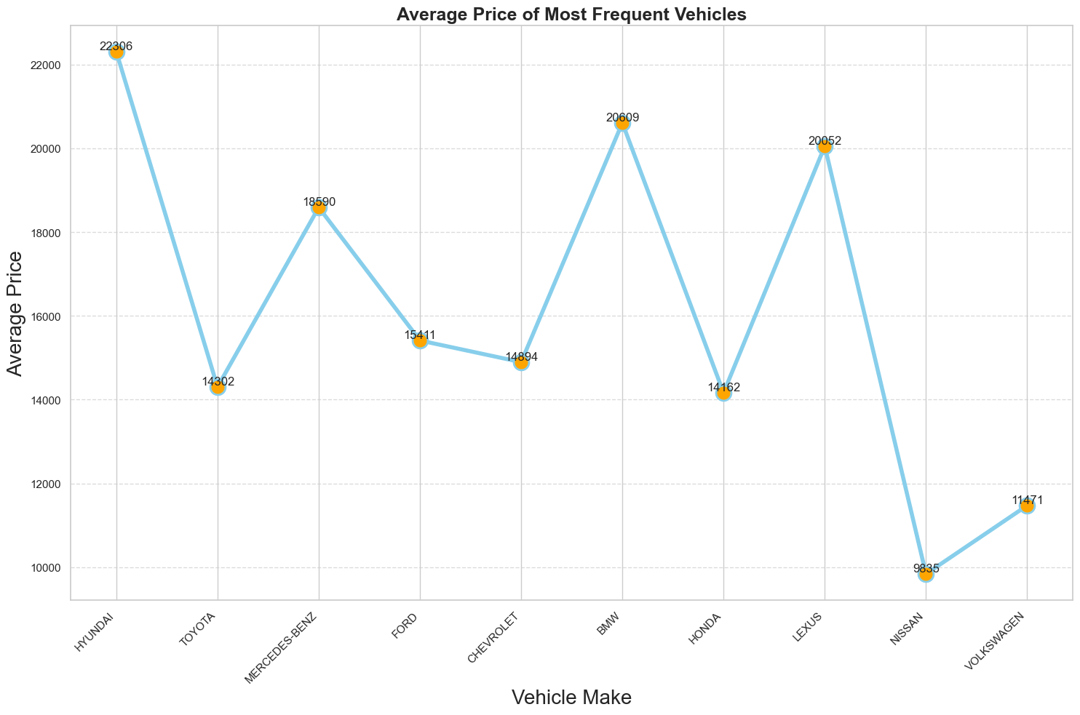
About the Data:

Slide 4
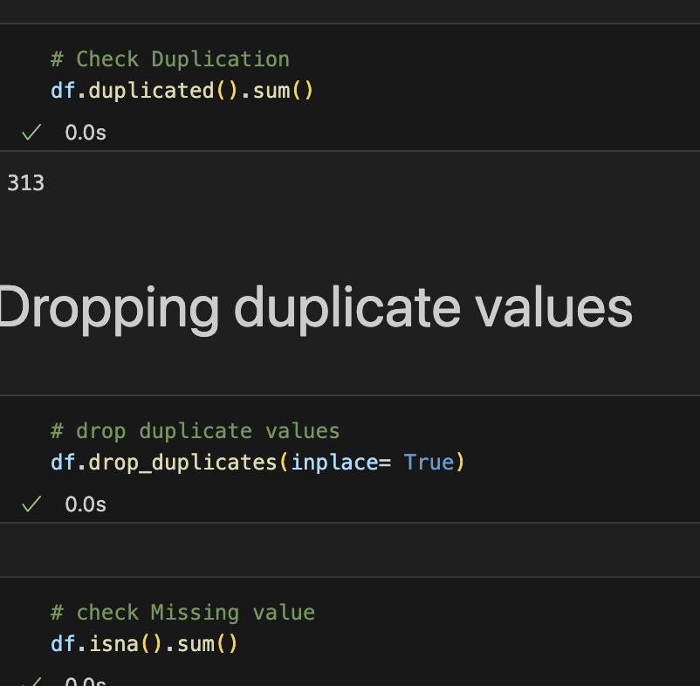
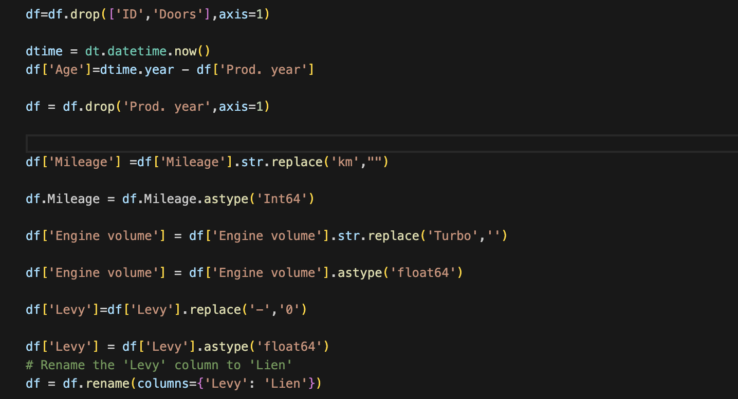
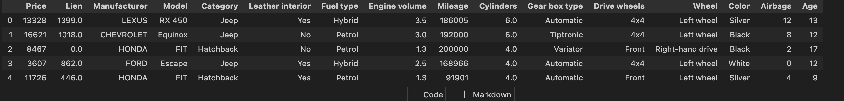
Data Cleaning/Preprocessing:
Column Removal:
Dropped irrelevant columns ('ID', 'Doors').
Age Calculation:
Created 'Age' based on production and current year.
Numeric Data Cleaning:
Processed 'Mileage', 'Engine volume', 'Levy'.
Preprocessing Steps:
Converted object columns to numerical using Label Encoding.
Addressed missing values, duplicates, and outliers.
Snapshot:
Display a cleaned and preprocessed dataset snapshot.

Slide 5
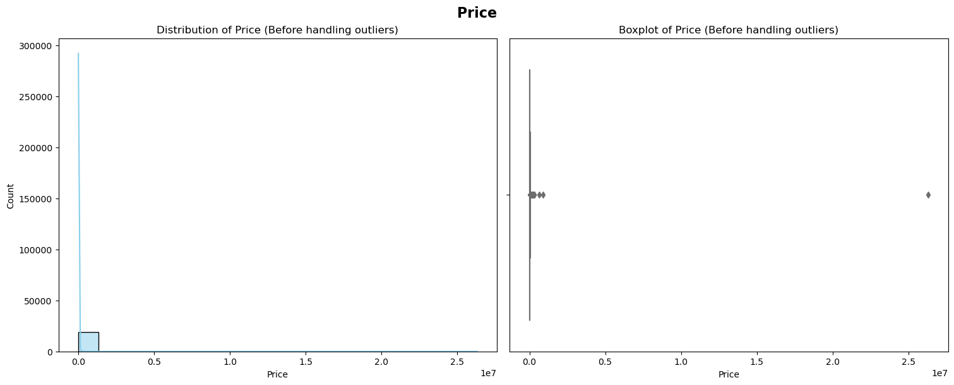
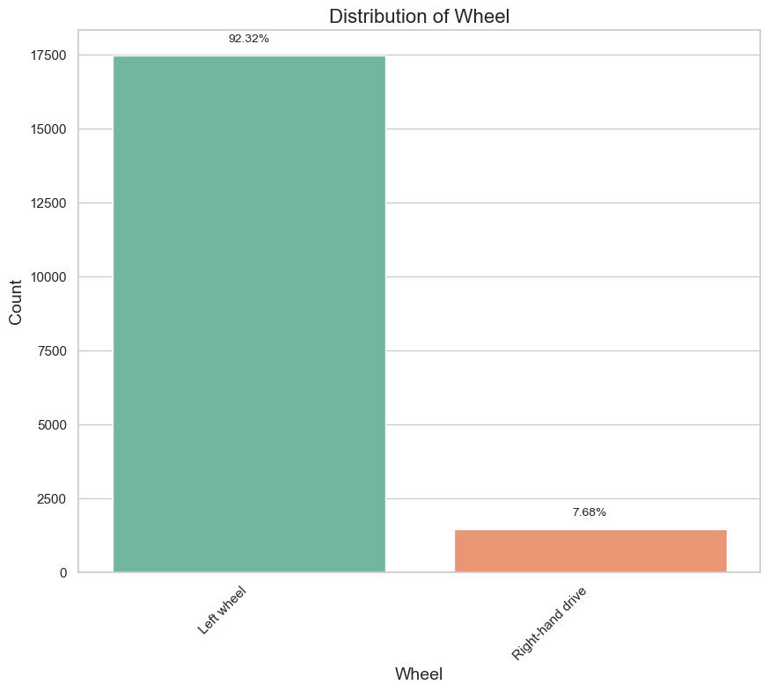
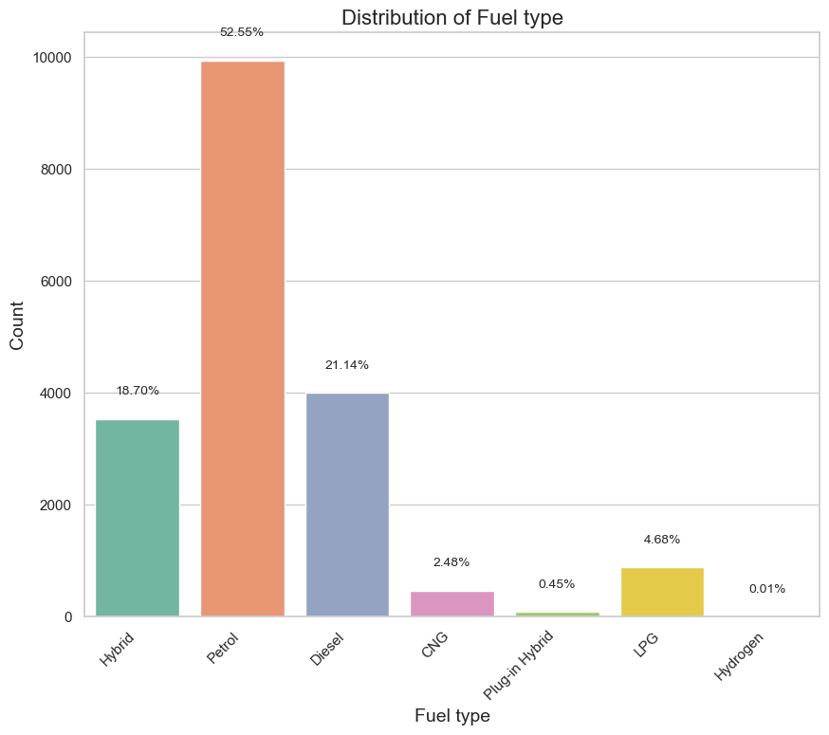
Exploratory Data Analysis (EDA)
Utilized histograms, count plots, and scatter plots for visual exploration.
Identified popular car categories, dominant colors, and frequent manufacturers.
Key Findings:
Common car categories: Sedan, Hatchback, Jeep.
Dominant colors: Black, Silver, White, Grey.
Frequent manufacturers and their average prices.

Slide 6
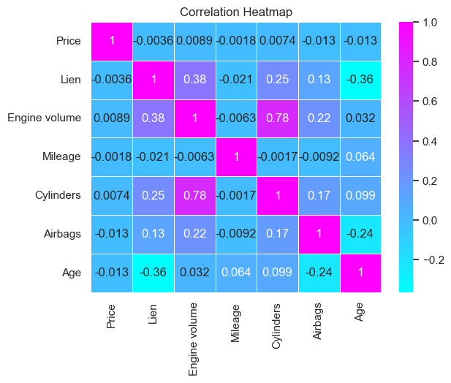
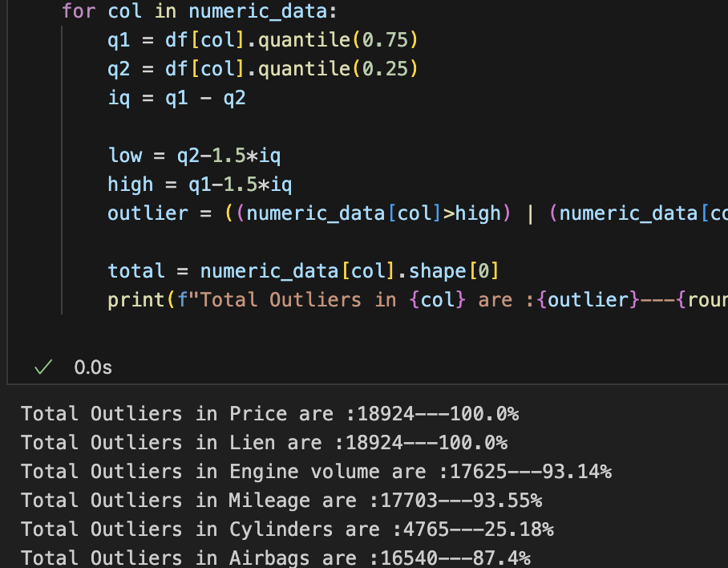
Correlation Analysis and Outlier Detection
Correlation Heatmap:
Objective: Visualize the relationships between numeric features.
Method: Use a heatmap to display correlation coefficients.
Insights: Identify strong correlations that may influence vehicle prices.
Example: A positive correlation between "Engine volume" and "Price" may suggest that larger engines contribute to higher prices.
Outlier Detection:
Objective: Identify and handle outliers in numeric columns.
Visualization: Side-by-side boxplots before and after treatment.
Importance: Outliers can skew predictions; their removal enhances model reliability.
Example: Outliers in "Mileage" or "Levy" may distort price predictions; their treatment ensures more accurate modeling.

Slide 7

Model training
Data Preparation:
Split the dataset into training and testing sets.
Define features (X) and target variable (y).
Linear Regression Model:
Utilized the scikit-learn library.
Chose Linear Regression for its simplicity and interpretability.
Training Process:
Model fitted using the fit method on the training data.
Utilized the training data to learn the relationships between features and target variable.
Performance Evaluation:
Utilized R2 Score and Root Mean Squared Error (RMSE) as performance metrics.
Assessed how well the model generalizes to unseen data.
Results:
Obtained insights into the model's ability to predict vehicle prices.
Evaluated the model's performance through R2 Score and RMSE.

Slide 8

Improvements
Feature Engineering:
Explore additional features that could enhance predictive power.
Advanced Algorithms:
Experiment with more complex algorithms
Outlier Treatment:
Investigate and address the impact of outliers on model performance.
Hyperparameter Tuning:
Optimize hyperparameters for better model performance.

